Slide 1
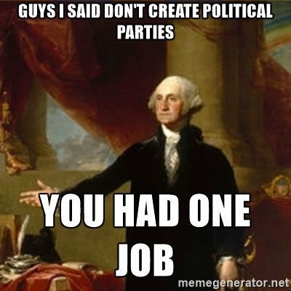
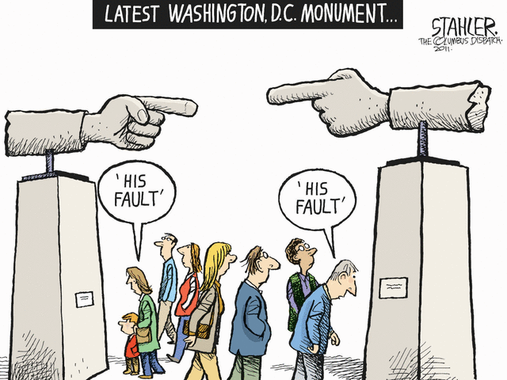
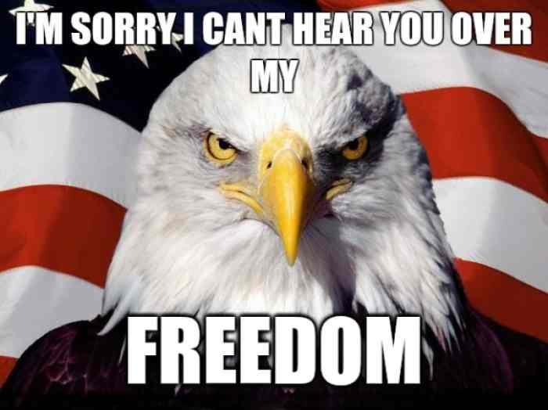
Civics Quiz Review
Making the Unit 3 Lesson 5 Quiz Fun!!

Slide 2
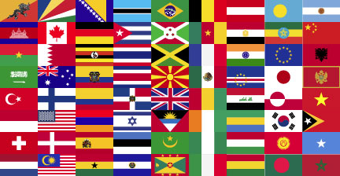
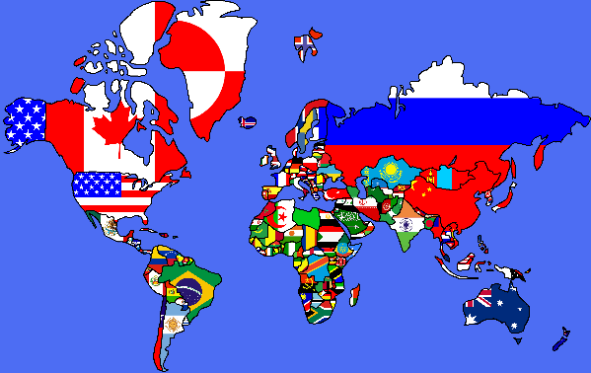
United States and the World
Into what basic units is the world broken up into?
Nation-States, better know as countries, which are all equal actors on the world stage.
What bonds create the need for a Nation State?
Shared Culture
Common Religion
Shared Past
Common Language
Common territory in which the people live

Slide 3
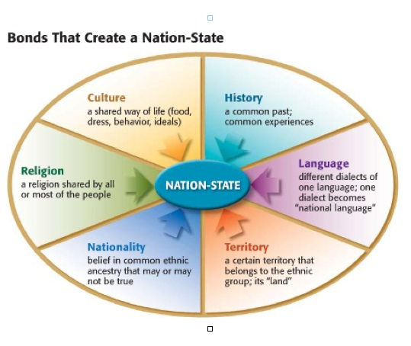
United States and the World

Slide 4
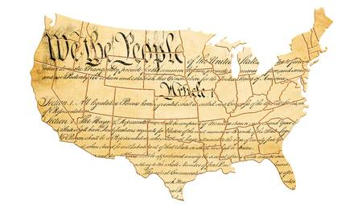
United States and the World
What characteristics do Nation’s possess?
A nation is defined by four characteristics: population, territory, sovereignty, and government.
Population:
A nation has to have a population, or people. You have often heard expressions like "the American people," or "the peoples of the Middle East." These populations form the “nation” part of the nation, and without them a nation cannot exist
Territory:
Territory is the land, waterways, and sea controlled by a country.
Sovereignty:
A population can only be considered a nation if they have sovereignty: that is, the right to rule themselves collectively.
Government:
a state must also have an organized government. An organized government is a government with clear positions and leaders, each with clear powers and responsibilities. There are no specific types of governments required. Governments can change and the nation-state remains the same.

Slide 5
United States and the World
What is the United Nations (UN) and what is it’s role?
The United Nations is an international organization created after World War II.
Its job is to help make international relations easier to maintain, create international standards for human rights, guide cooperation on economic development and humanitarian causes, and oversee peacekeeping and security efforts.
It resolves problems through mediation, arbitration, or sanctions
In mediation, the neutral party is there to help the two conflicting sides work the problem out for themselves.
In arbitration, the neutral party is given the authority to determine a fair solution, and the conflicting parties agree to accept that solution.

Slide 6
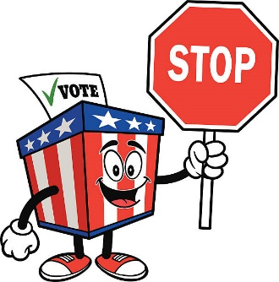
Limited vs. Unlimited Government
Limited governments:
are affected by rules and laws that state what the government can and cannot do. The U.S. government is a type of limited government called a constitutional republic.
Unlimited governments:
have no restrictions placed on their powers. Citizens do not have rights that are protected by a constitution or other enforceable law. The leader of an unlimited government may make laws without asking a legislature or voters. Unlimited governments can become abusive and may take advantage of their citizens. They often use violence and intimidation to enforce their authority.

Slide 7
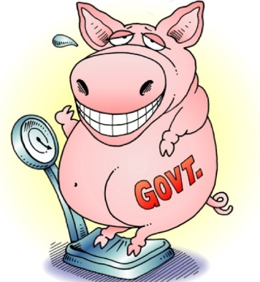
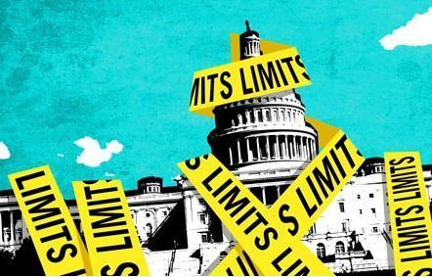
Limited vs. Unlimited Government
What limits a government?
What protects the citizen from the government within a limited government?
What are some examples of these limits placed on government based on our own Constitution?

Slide 8
Civic life vs. Private Life
Private life refers to all the things that citizens do for themselves, what are some examples?
Civic life consists of the actions that people take as part of a community or a government, what are some examples?

Slide 9
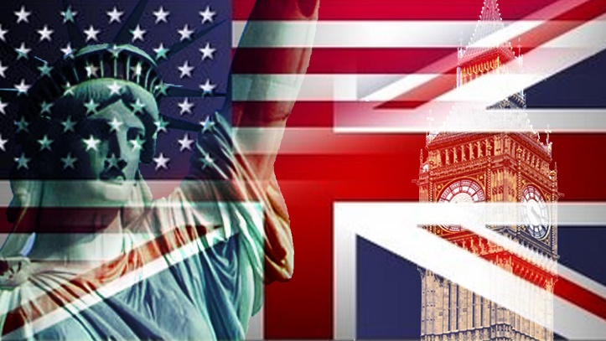
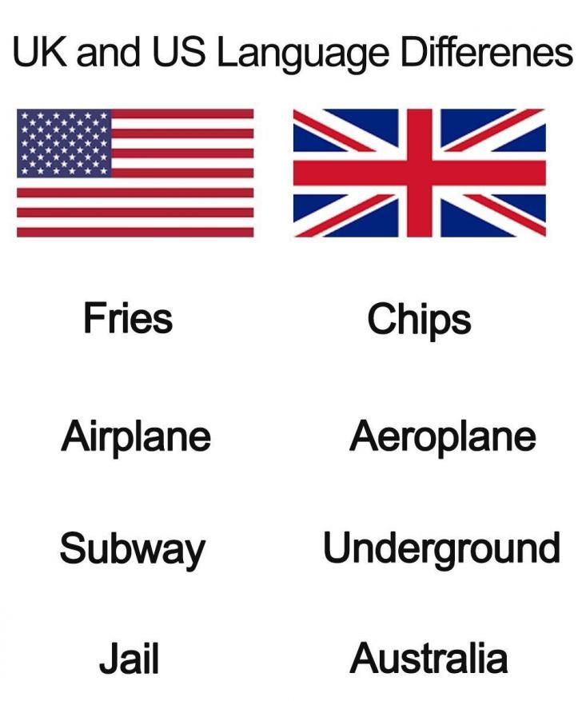
Comparing the Governments of US and Britain

Slide 10
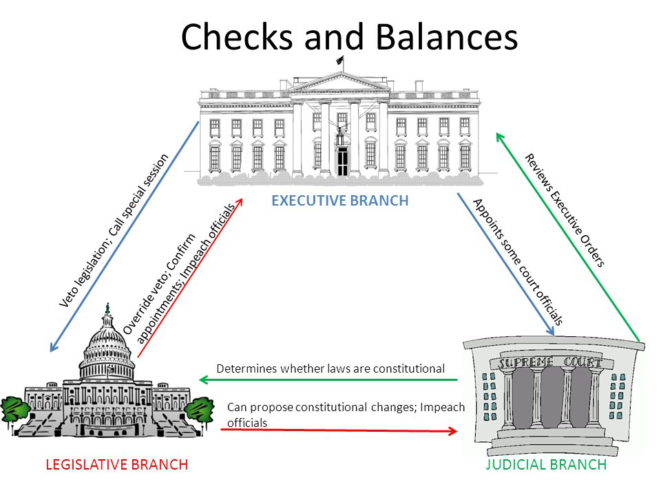
What are some benefits to a system of checks and balances within the government structure?
What are disadvantages to this system?

Slide 11
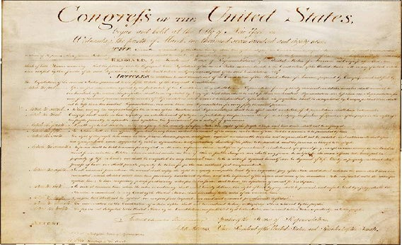
The Bill of Rights: Protecting YOU from the Government

Slide 12
