Slide 1
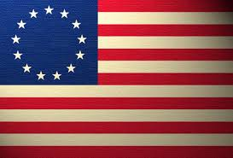
The Declaration of Independence

Slide 2
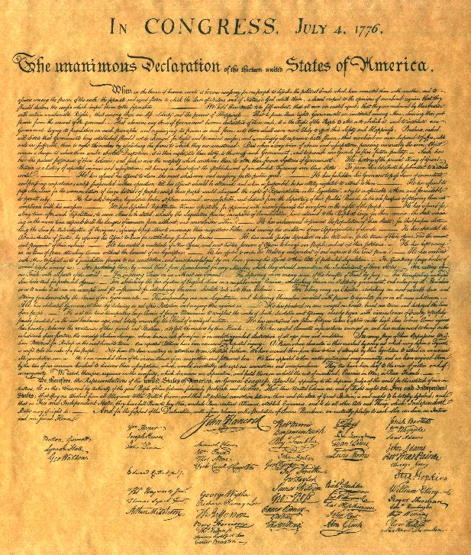
The Declaration of Independence
Lets take a closer look by answering three main questions about this document:

Slide 3
Declaration of Independence:
The Preamble listed the basics rights that all men should have, what were some of those rights?
The declaration also listed the grievances that the Colonists had against King George and Britain, what were some of these grievances?
The declaration also declared the United States as a sovereign nation, why was this important?

Slide 4
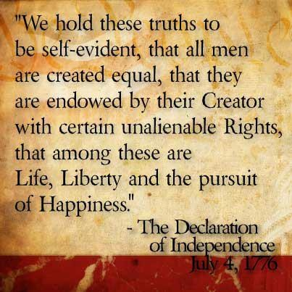
Declaration of Independence:
The Preamble listed the basics rights that all men should have, what were some of those rights?

Slide 5
Declaration of Independence:
The Preamble listed the basics rights that all men should have, what were some of those rights?
Endowed by the Creator
Unalienable
Right to Life, Liberty, and the Pursuit of Happiness

Slide 6
Declaration of Independence:
The declaration also listed the grievances that the Colonists had against King George and Britain, what were some of these grievances?
Quartering large amounts of troops amongst the colonists
Cutting off trade with the rest of the world
Imposing taxes without consent of the colonists
Depriving colonists of their basic rights

Slide 7
Declaration of Independence:
The declaration also declared the United States as a sovereign nation, why was this important?
“When in the Course of human events, it becomes necessary for one people to dissolve the political bands which have connected them with another…a decent respect to the opinions of mankind requires that they should declare the causes which impel them to separate.”
When it is necessary for people to separate from their government, these people need to tell others the reasons why they are separating.

