Slide 1
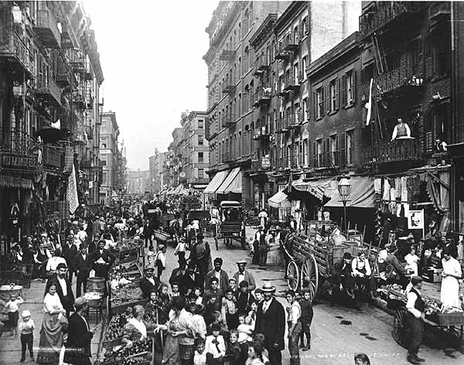
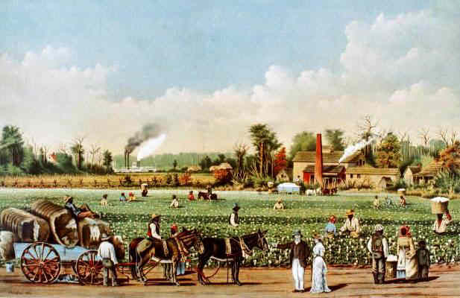
Life in the North Life in the South

Slide 2
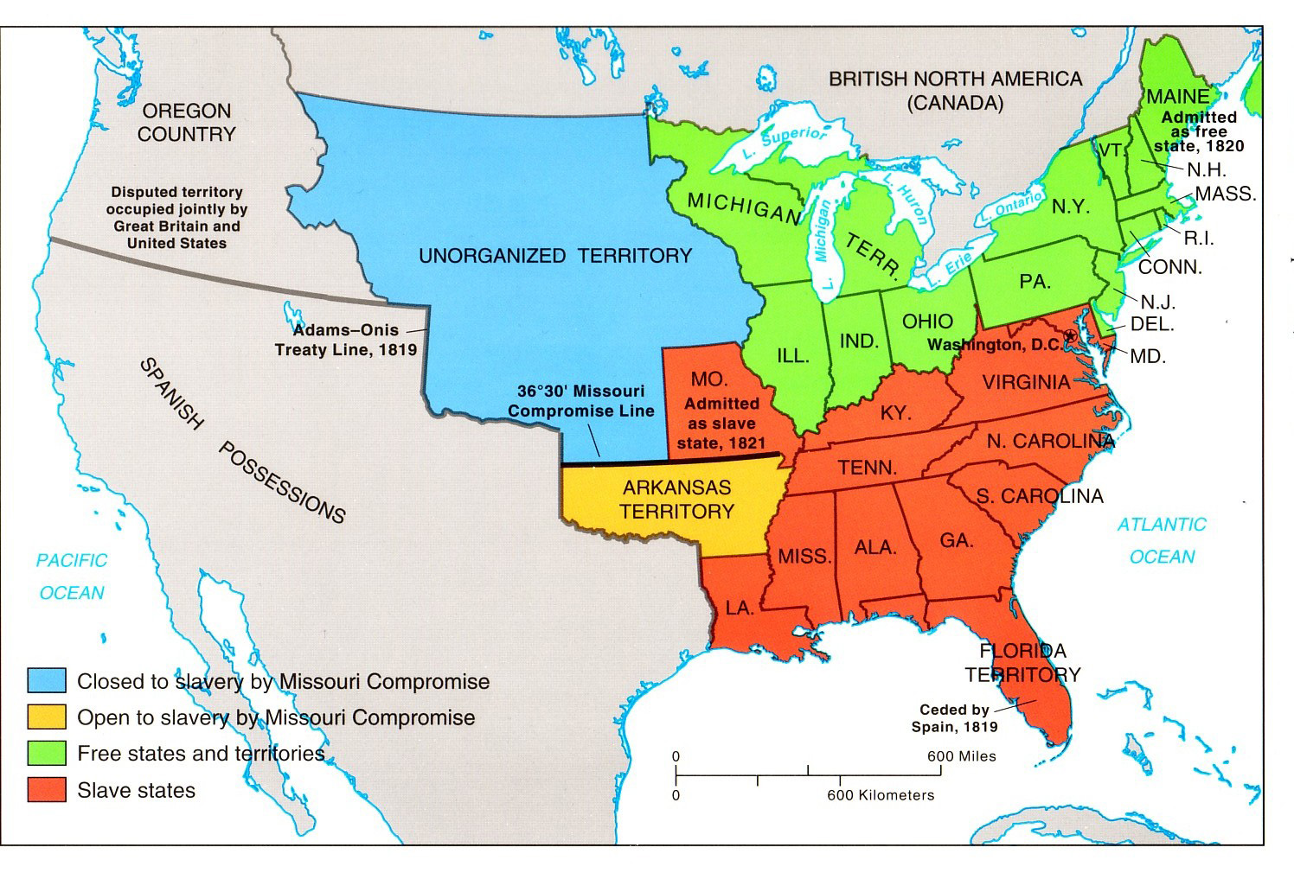
North and South?

Slide 3
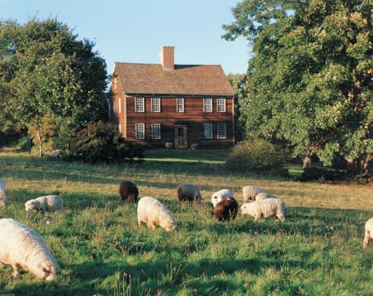
Life in the North
The land is rocky, hilly, and has many forests.
Most farms were small single family farms
No need for slaves

Slide 4
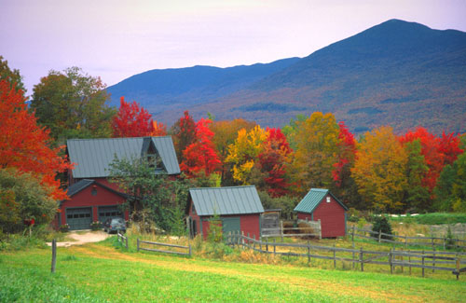
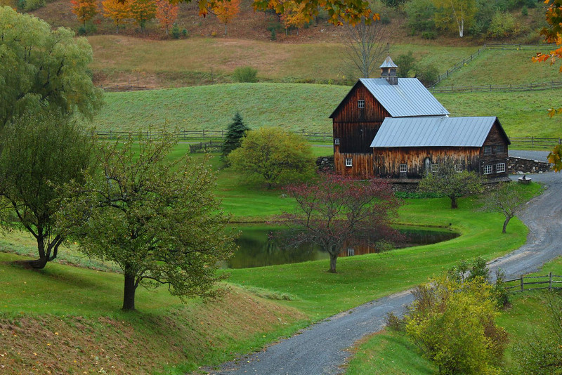
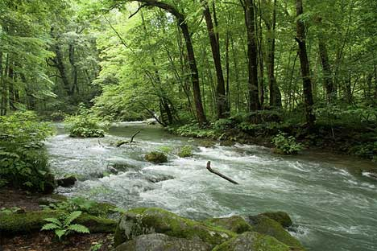
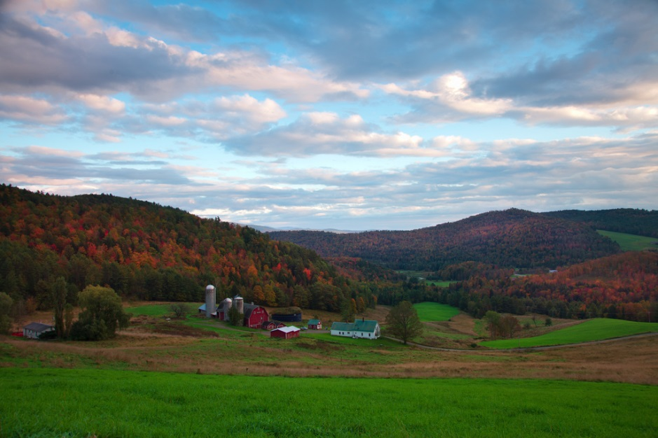
Life in the North

Slide 5
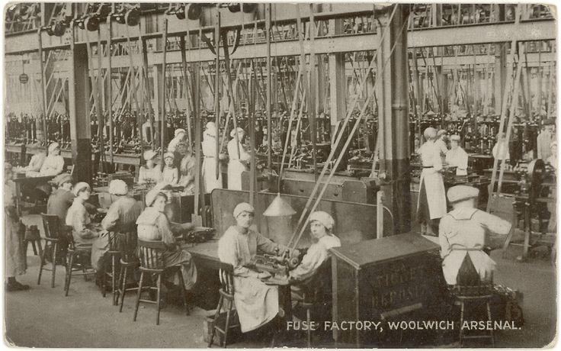
Life in the North
Economy was based on industrial production
Supported strong tariffs to support local factories
Supported a strong Federal Government

Slide 6
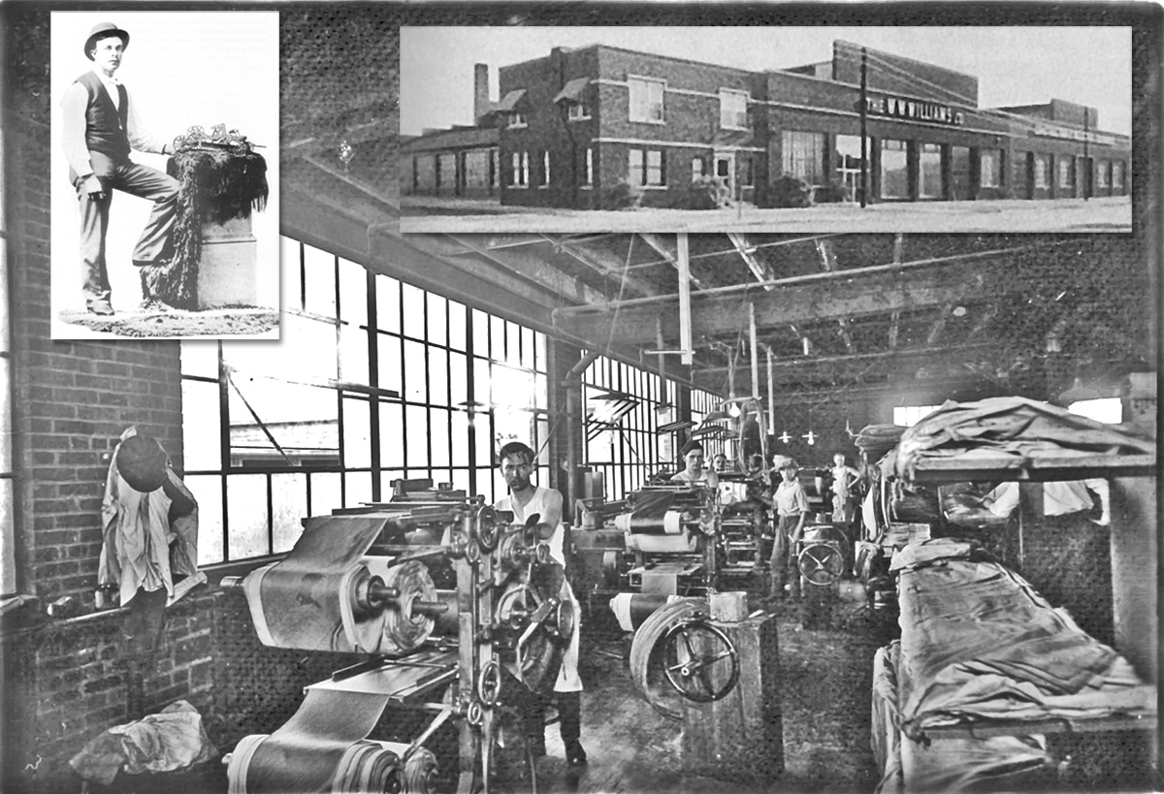
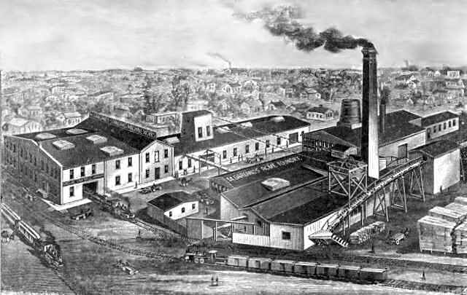
Life in the North

Slide 7
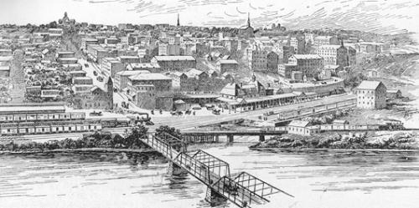
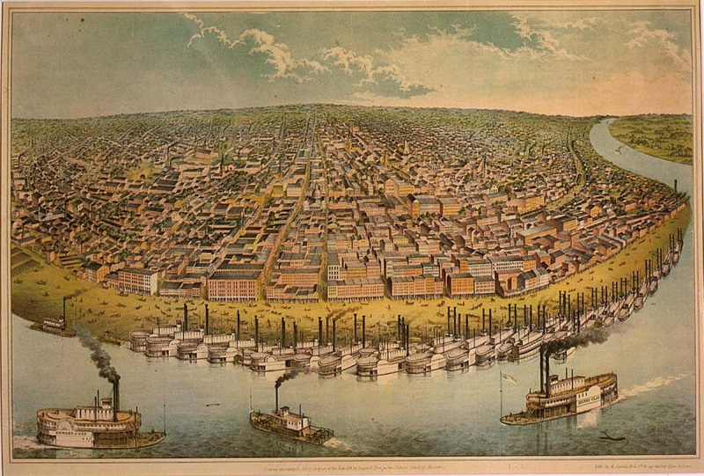
Life in the North
Most of the population lived in large cities like Boston, New York, or Philadelphia.

Slide 8
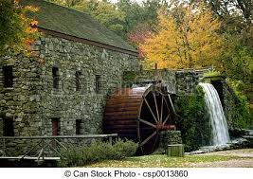
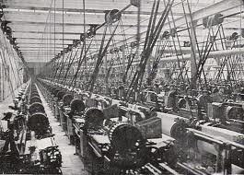
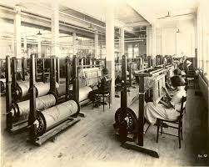
Life in the North
New England had a workforce because people were willing to leave their difficult lives as farmers
It had fast moving waterways to run the factory machinery
Nearby resources included Coal and Iron
Shipping ports were located nearby
Merchants in the area had money and were willing to invest

Slide 9
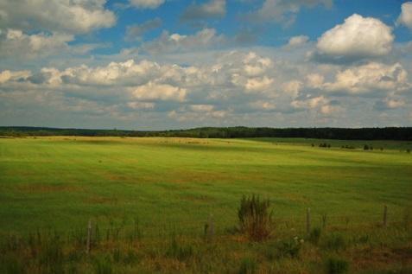
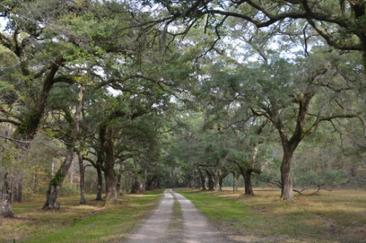
Life in the South
Land is soft, fertile with plenty of rainfall, temperatures are warm most of the year.

Slide 10
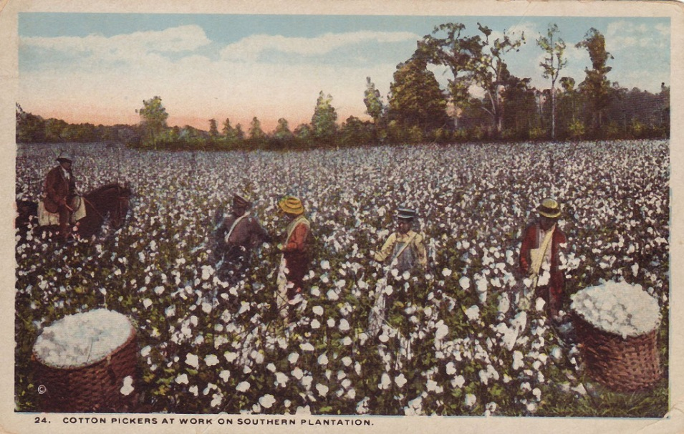
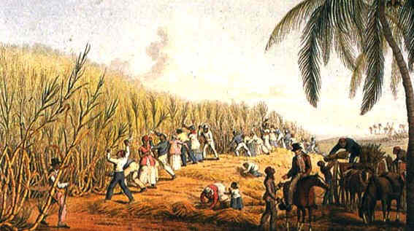
Life in the South
Large plantations with many workers.
Slave labor was needed to run the plantations.

Slide 11
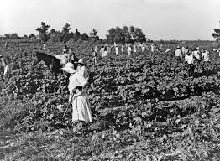
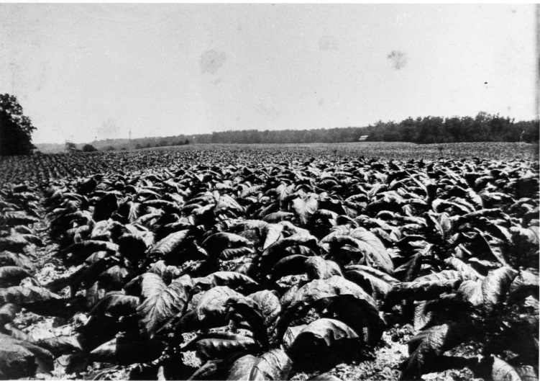
Life in the South
Economy was based on agricultural production (cotton).
Believed tariffs only increased prices in the South.
Supported local or state governments because they better represented local groups.

Slide 12
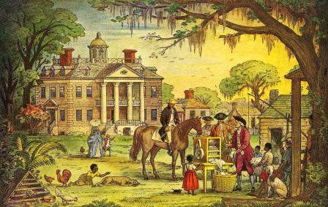
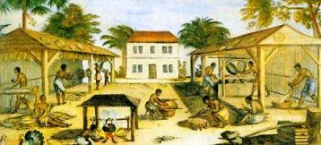
Life in the South
Most people live in rural areas or around plantations.
Very few large cities.

Slide 13
Lets Compare:
North Region:
Land is rocky and hilly
Small single family farms
No need for slaves
Economy is based on Industrial Production
Support strong tariffs to encourage American products
Support large Federal Government (federalists)
Most of the population lived in large cities
South Region:
Land is soft and fertile with plenty of rainfall, temperatures stay warmer longer
Large plantations with many workers
Slave labor was a necessity
Economy is based on Agricultural Production
Believed tariffs only increased the prices of goods produced in the North
Supported state rights and wanted a small Federal Government (Democratic Republicans)
Most of the population lived in rural areas.

