Slide 1
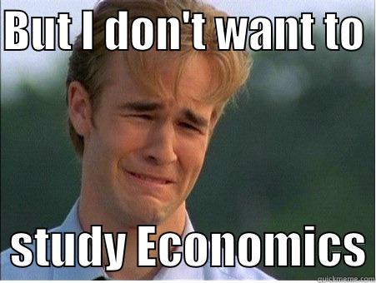
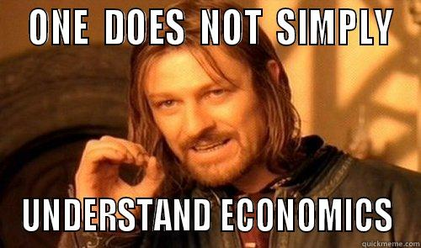
Economic Basics
More fun than you think

Slide 2
What is Economics?

Slide 4
Now let’s think about the free A scenario and talk about the following:
Scarcity – What was limited in this scenario?
Opportunity Cost – What did you have to give up?
Opportunity Benefit – What did you gain?

Slide 5
Now let’s think about the free A scenario and talk about the following:
Supply– What is being supplied? How much?
Demand– What good or service is being demanded?
Incentives– What are the incentives involved in this situation?

Slide 6
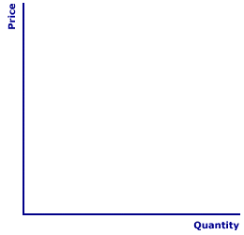
How is Price Determined?

Slide 7
Application:
Consuela has a leaf raking business. She charges $15 per yard and she works two days a week. Recently a storm blew through the neighborhood and many leaves fell.
How does this affect demand for leave raking?
What does increase demand do to the price of leaf raking?
What is Consuela likely to do? Why?

Slide 8
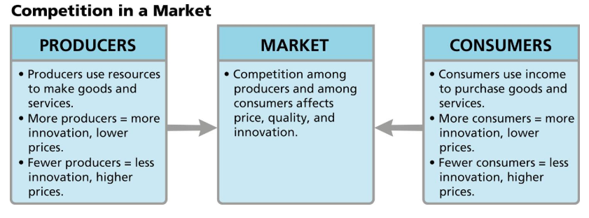
How is Price Determined in a Market?

Slide 9
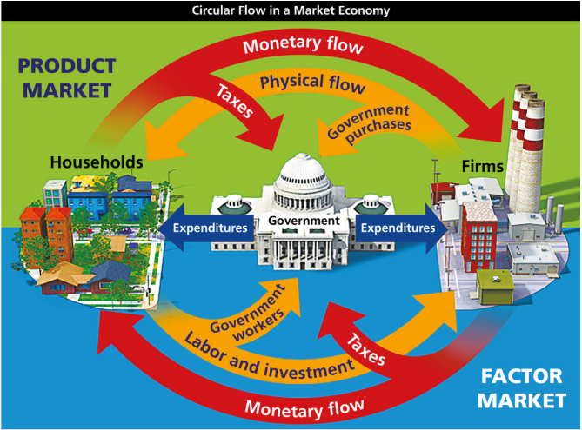
Is government necessary in a market system? Why?
What role might government serve in a market?

Slide 10
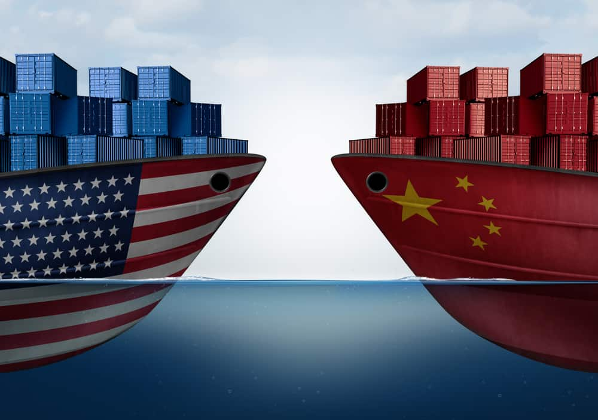
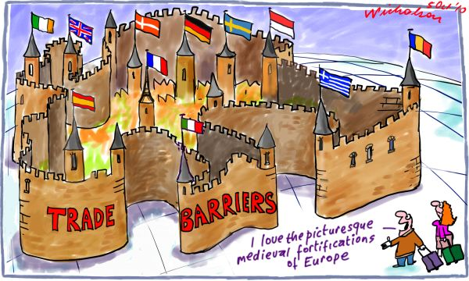
International Markets:
What is a trade barrier?
A government policy or restriction that limits international trade.
What are some examples of trade barriers?
Tariff
Quota
Embargo

Slide 11
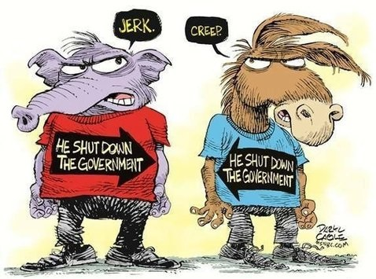
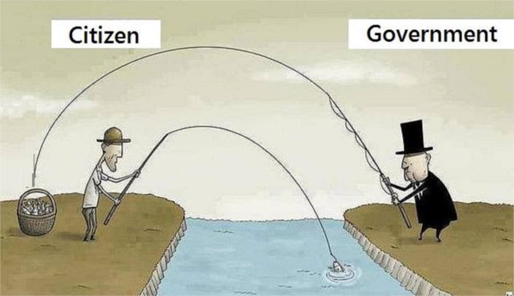
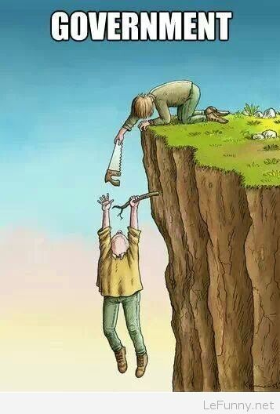
Government Basics:

Slide 12
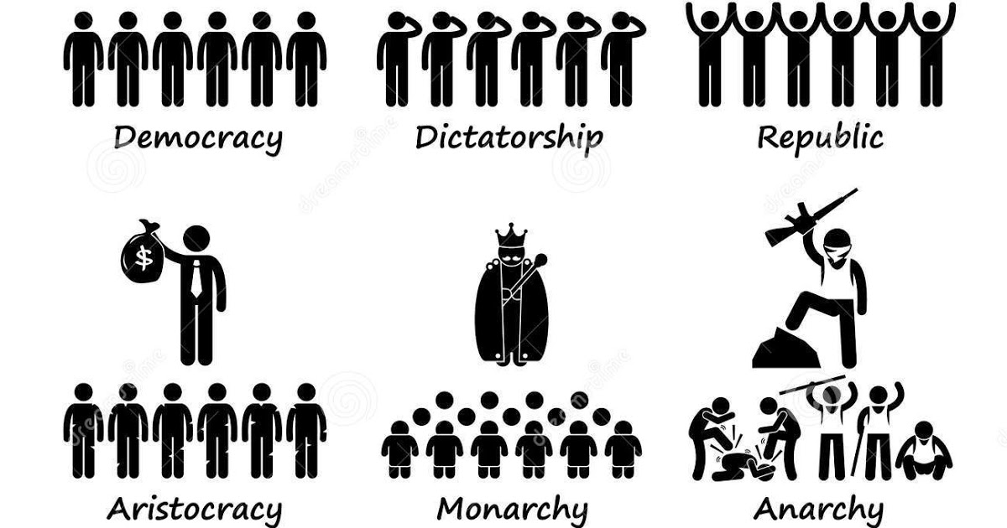
What type of Government?

Slide 13
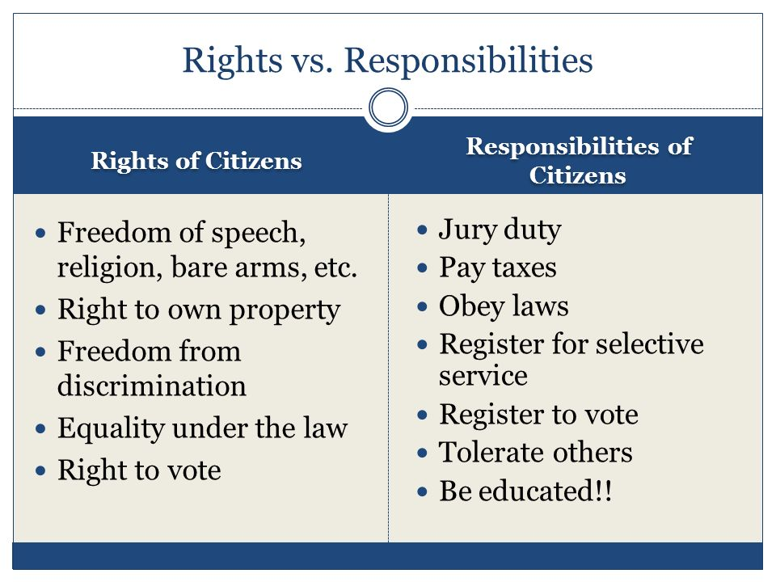
What is the difference between a Right and a Responsibility?

Slide 14
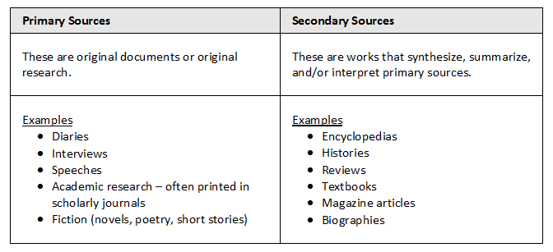
What is the difference between a Primary and Secondary source?

