Slide 1
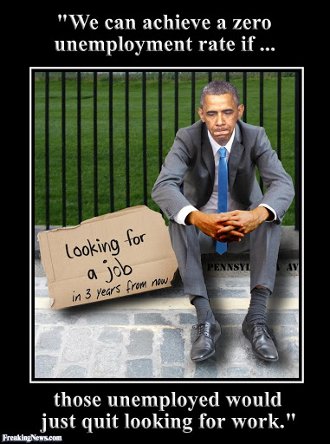
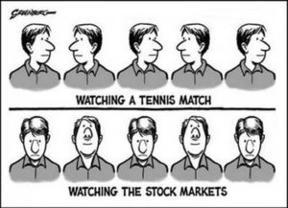
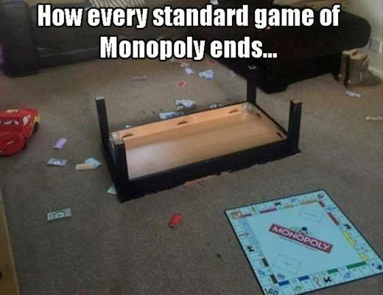
Unemployment, Investment, and Monopolies
AKA: Your last live lesson on Econ!!!

Slide 2
How do we measure unemployment?
What does the unemployment rate measure? What does it mean to be unemployed?
If you are a student in college with no job are you unemployed?
If you are a stay-at-home parent are you unemployed?
The unemployment rate is a measure of the percentage of people who want to work, are able to work, but cannot find a job. It focuses only on the labor force—or those people over the age of 16—who are willing and able to work and who are presently working or looking for work.

Slide 3
How do we measure unemployment?
There are actually four different types of unemployment:
frictional unemployment – When a worker is temporarily out of work during a move from one job to another, it is frictional unemployment. This might be something as simple as the right candidates for a job not being in the city where the job is located.
structural unemployment – This is unemployment that results from industrial reorganizations. These reorganizations are usually due to technological changes or environmental factors such as natural disasters or ecological shifts. Structural unemployment is not usually associated with supply and demand.

Slide 4
How do we measure unemployment?
There are actually four different types of unemployment:
cyclical unemployment – This is unemployment resulting from trade cycles in a capitalist economy. Trade cycles include periods of recession that can lead to unemployment, as demand and production slow down and companies don’t need all of the employees that were needed for periods of high production.
casual unemployment – This is unemployment associated with short-term contracts. Some industries, like catering or the film industry, employ workers on a day-to-day basis. When a contract ends, the worker must get another job and may be unemployed for a time.

Slide 5
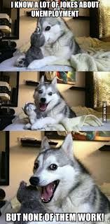
How do we measure unemployment?

Slide 6
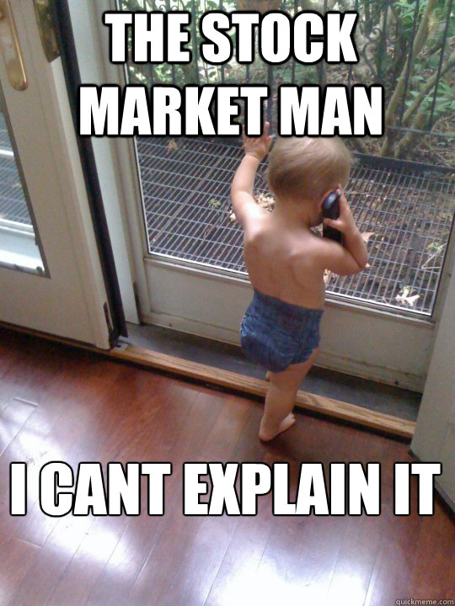
Let’s explore the types of investments

Slide 7
The Three Types of Investments:
The first type is called an ownership investment.
An ownership investment is an investment such as a stock or real estate that is higher risk, which entitles you to actual ownership of all or part of a property. However, there is the possibility that you could lose your initial investment, making these investments higher risk. Higher-risk investments are attractive to some investors because they tend to be the most profitable when they are successful.
Stocks, businesses, real estate, and precious objects (a Van Gogh painting, for example) are all ownership investments.

Slide 8
The Three Types of Investments:
The second type of investment is a lending investment, which is an investment such as a bond or a savings account in which other groups borrow money from you and promise to pay it back with interest.
These investments are lower risk, which means your money is more stable, but they typically don’t have as high a payout. Even a simple savings account is considered an investment. When you have a savings account, you are effectively lending money to the bank, which then pays you interest.
Bonds are another type of lending investment. With a bond, you serve as the bank because you loan your money to a company, a city, or the government. In turn, they commit to paying you back in full, with interest.

Slide 9
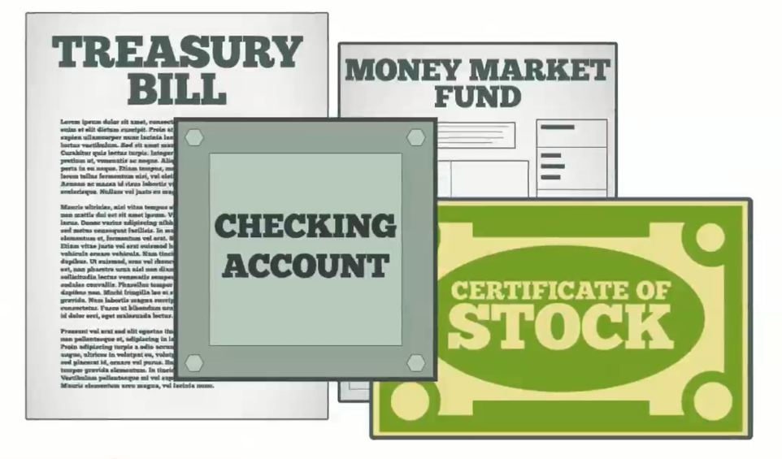
The Three Types of Investments:
The third type of investment is cash equivalent, which is an investment that is as good as cash, such as a money market account.
These investments are low risk.
They are very easy to turn back into cash, which means the funds are readily available in case you need to get the money back quickly. The trade-off for this is that they have a very low rate of return.

Slide 10
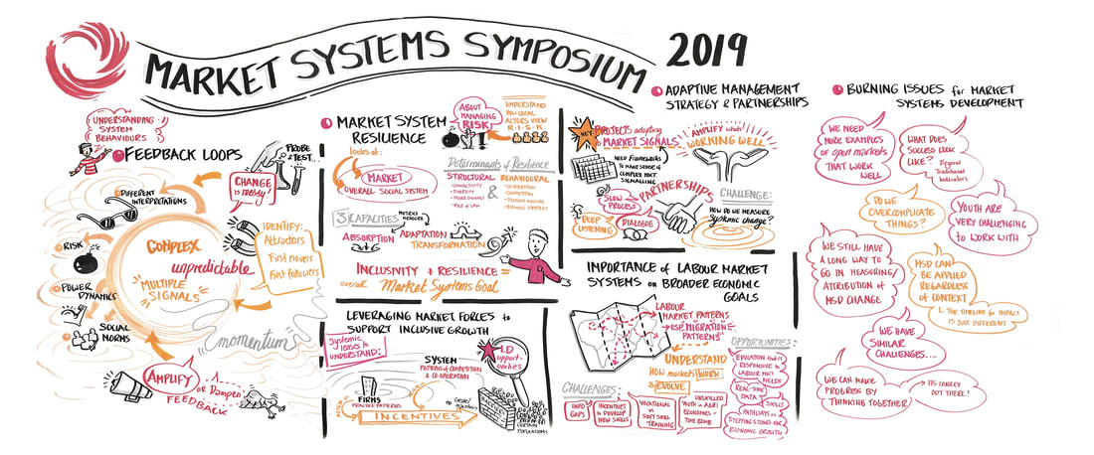
Characteristics of Markets:

Slide 11
Characteristics of Markets: A Monopoly
A monopoly is a firm that has no competitors in its industry. It occurs when one person (or firm) is in charge of all of the production in an industry.
In general, a monopoly does the following:
produces less output than firms in a competitive market would produce
sells its product at a higher price than the market equilibrium price would have been had there been a competitive market
produces the output less efficiently and at a higher cost than competitive firms would have produced the same product

Slide 12
Characteristics of Markets: An Oligopoly
An oligopoly is an economic situation in which there are only a handful of sellers (2, 3, or 4 at most). There are many different industries that are oligopolistic in nature, including soft drink companies, video game consoles, and computer-processing chip designers.
Firms involved in an oligopoly have two basic options in their relationships with each other:
The oligopolistic firms may choose to battle with each other in a no-holds barred economic competition for domination in the market; or
The firms may choose to unite and behave almost exactly like a monopoly would behave.

Slide 13
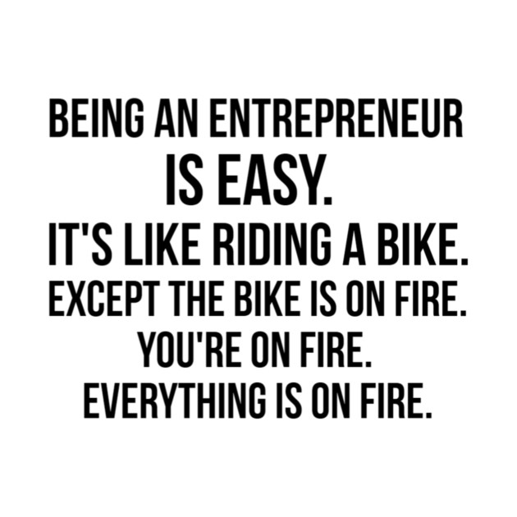
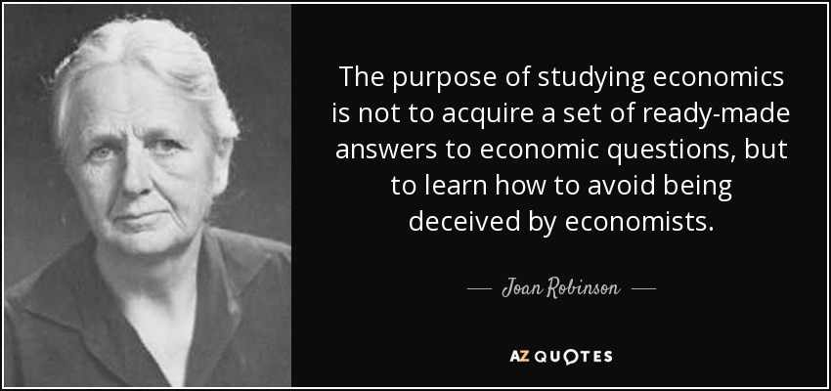
At this point I would normally tell you an amazing economics joke……
But there is clearly not enough demand

