Slide 1
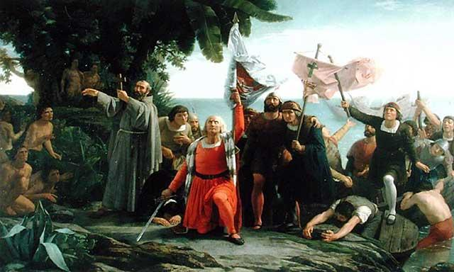
Different Worlds Meet

Slide 2
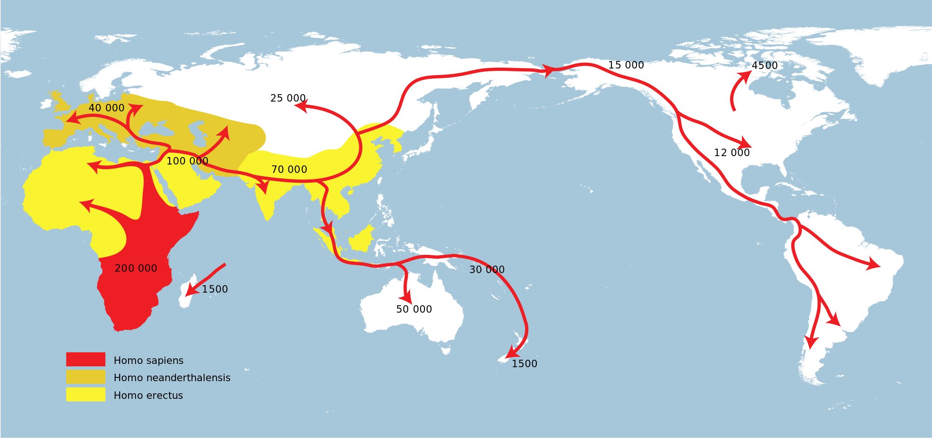
The Native American World
Thousands of years ago, hunter-gatherers begin to leave Africa and spread around the world.

Slide 3
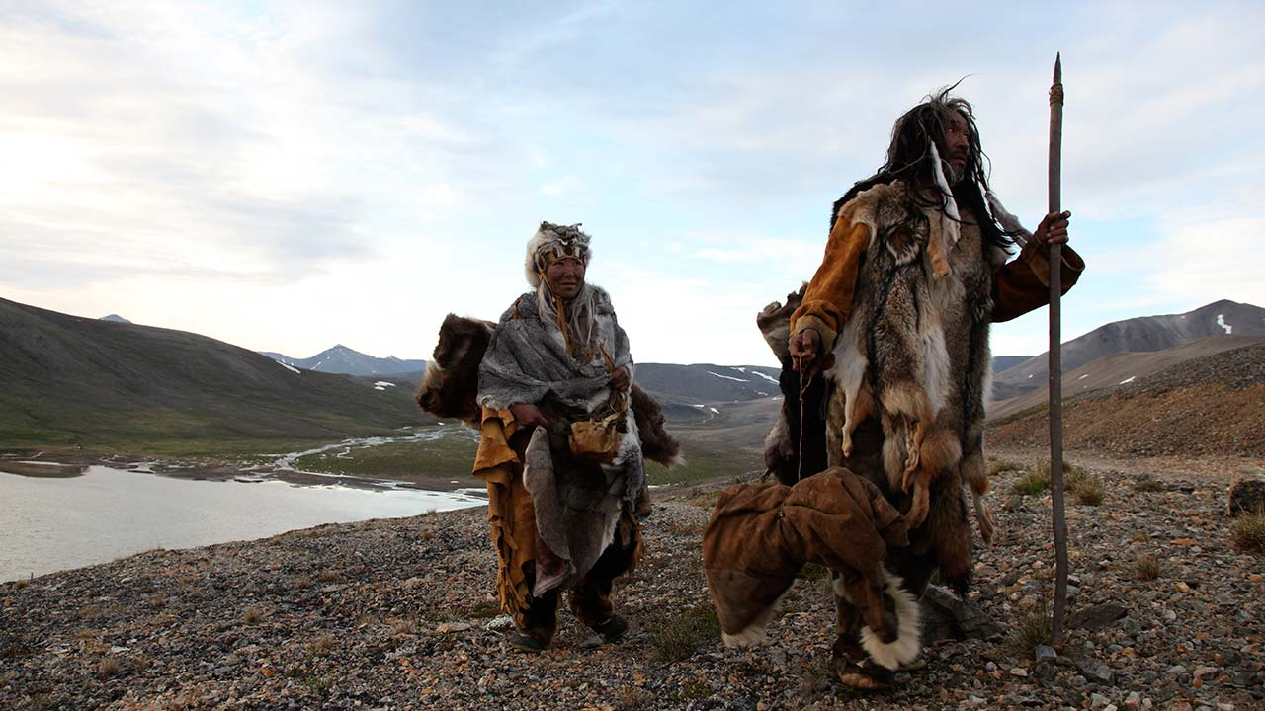
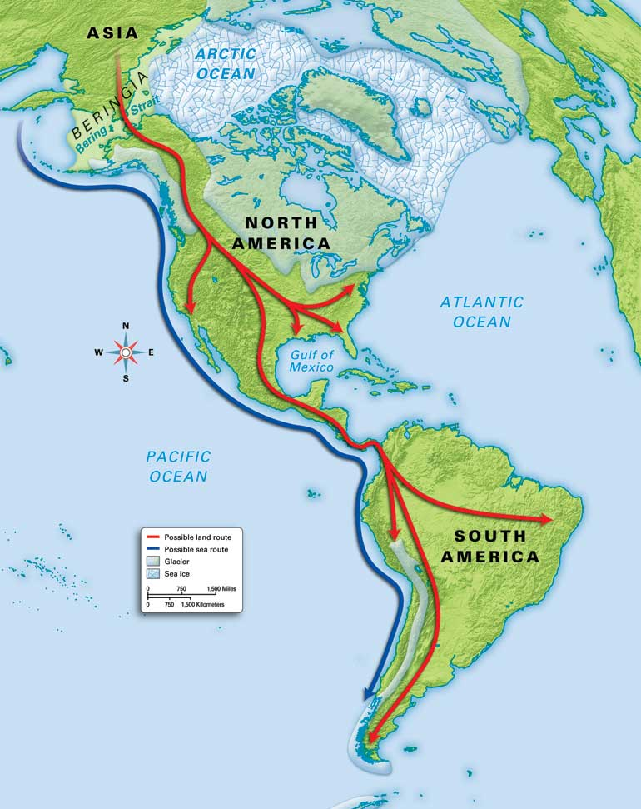
People arrive in the Americas
Around 15,000 BC, tribes begin to arrive in the Americas and settle down.
Why do you think early native explorers stayed so close to land as they travelled the sea routes to North and South America?

Slide 4
Hunter Gatherers convert to Agrarian Societies
Fire allows food to be converted more easily into energy and increases brain growth.
Stables crops, the understanding of the seasons, and the introduction of domestic animals allows tribes to settle in one area and build.
Division of labor increases the stability of societies and permanent tribal regions form.
Great societies in North and South America begin to emerge.

Slide 5
North America

Slide 6
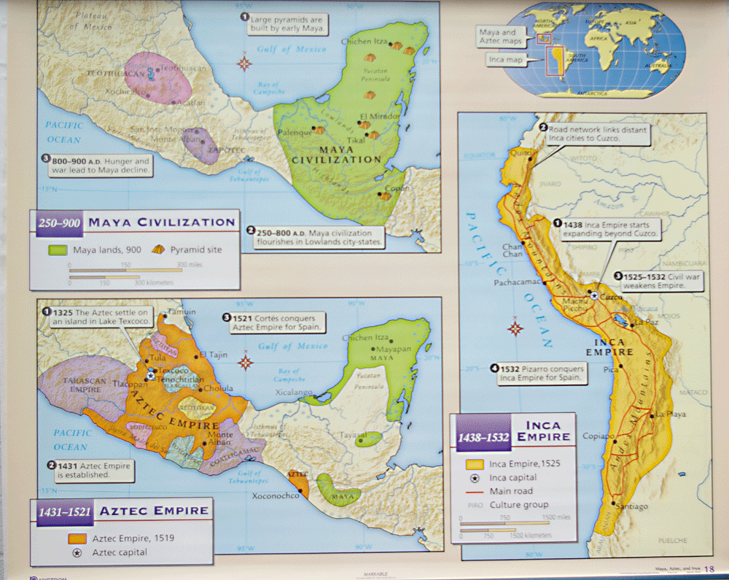
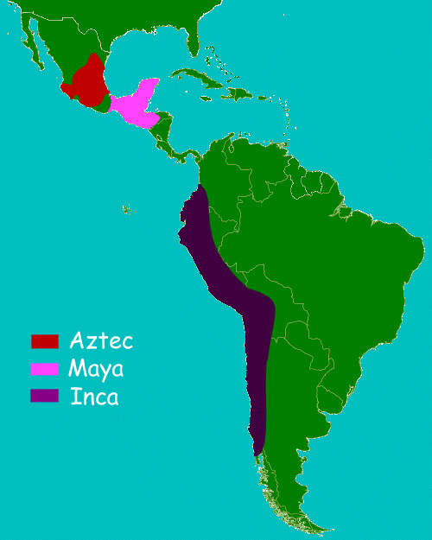
South America
Olmecs were the ancestors of the three major South American tribes: The Maya, Inca, and Aztecs

Slide 7
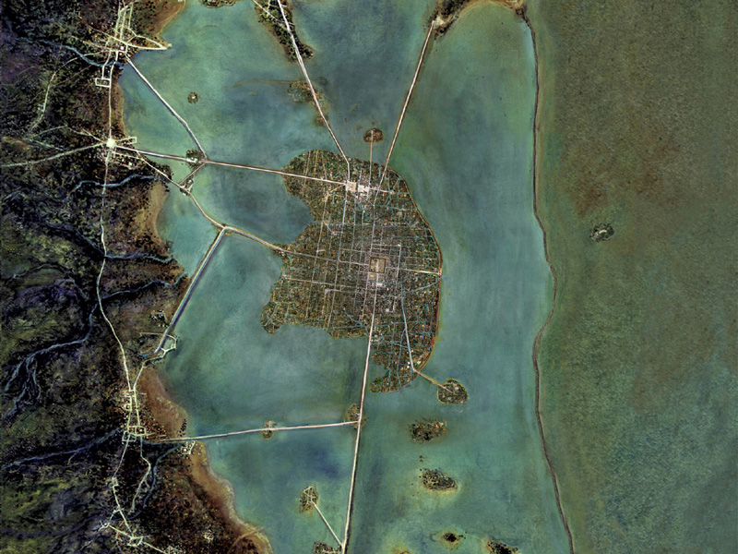
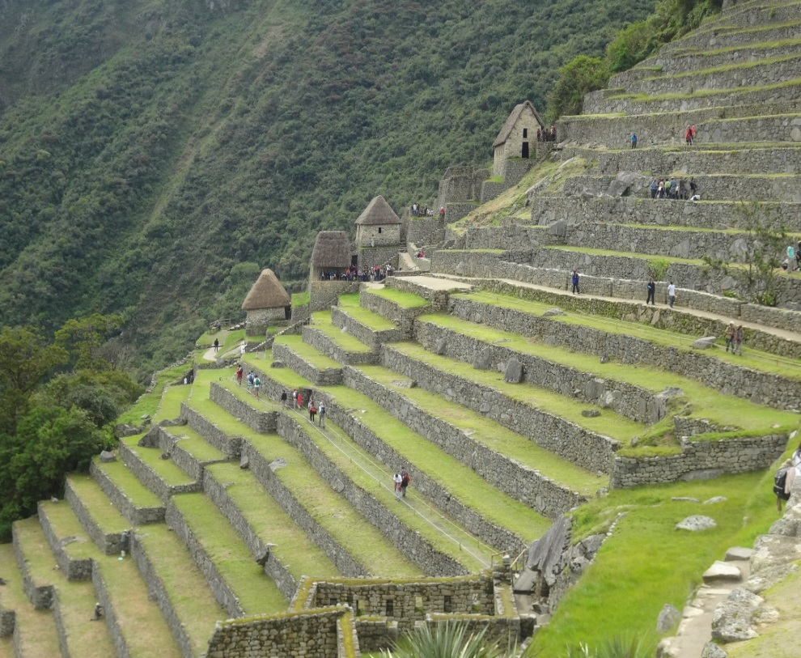
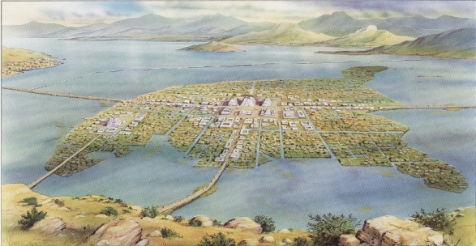
South America
Built epic causeways, Chinampas, and terrace farming.

Slide 8
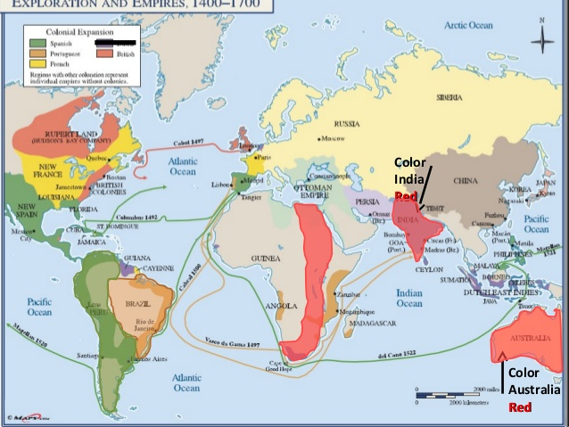
Different Worlds Collide
1492, Columbus lands on the Island of Hispaniola and claims it for Spain.
Within the next 20 years there are colonies in Central America, South America, North America and even Canada.
Within the next 50 years, the great civilizations of South America are destroyed and 72% of the Native population has been killed by European diseases.

Slide 9
The Spanish Conquistadors
Explored and Conquered Central and South America as well as parts of southern North America.
Instituted the encomienda system which was basically a system that enslaved the natives and made them work for their foreign masters.
Came to the New World for Gold, Glory, and God.

Slide 10
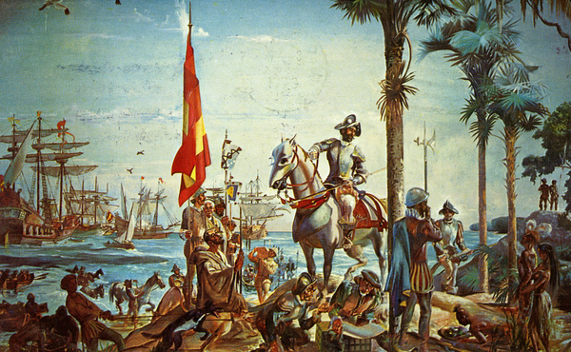
The Spanish Conquistadors
What actually killed most of the Natives that the Spanish came across?
How do you think the Spanish thought of the natives they encountered?

Slide 11
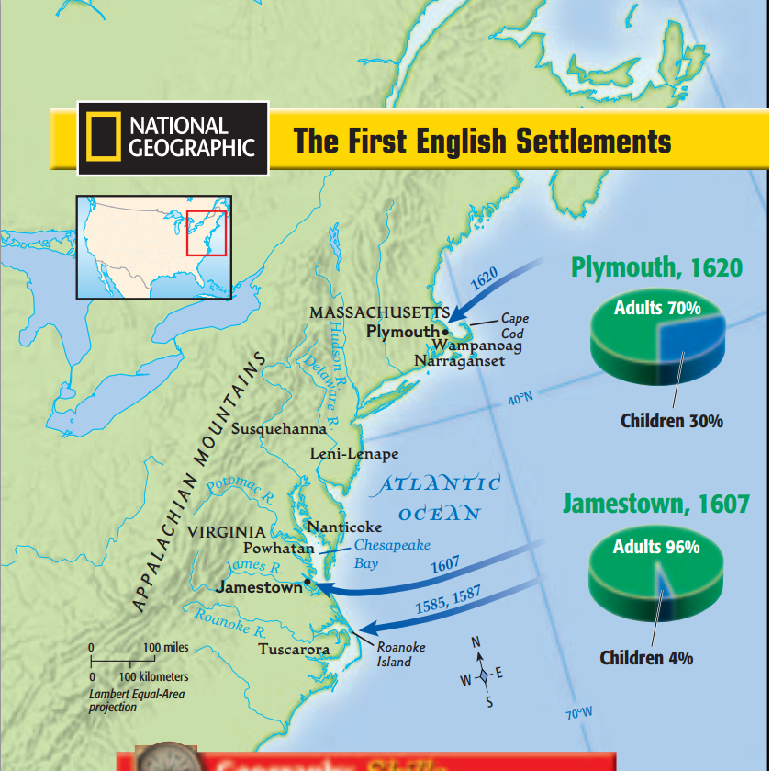
The English Settlers
Came to the New World to create profitable settlements that would ship raw materials back to England.
Later, many English colonists came to escape religious persecution by the church of England.
Settled along the coast of North America, mostly in the Virginia, New York or New England regions.

Slide 12
The First Settlement at Jamestown

Slide 13
The First Settlement at Jamestown
Colonists thought they would immediately find gold so many colonists were metalsmiths.
No one wanted to farm, so the colony was initially not successful and many died.
The growing of tobacco saved the colony and many indentured servants were brought over.
What is the difference between and indentured servant and a slave?

Slide 14
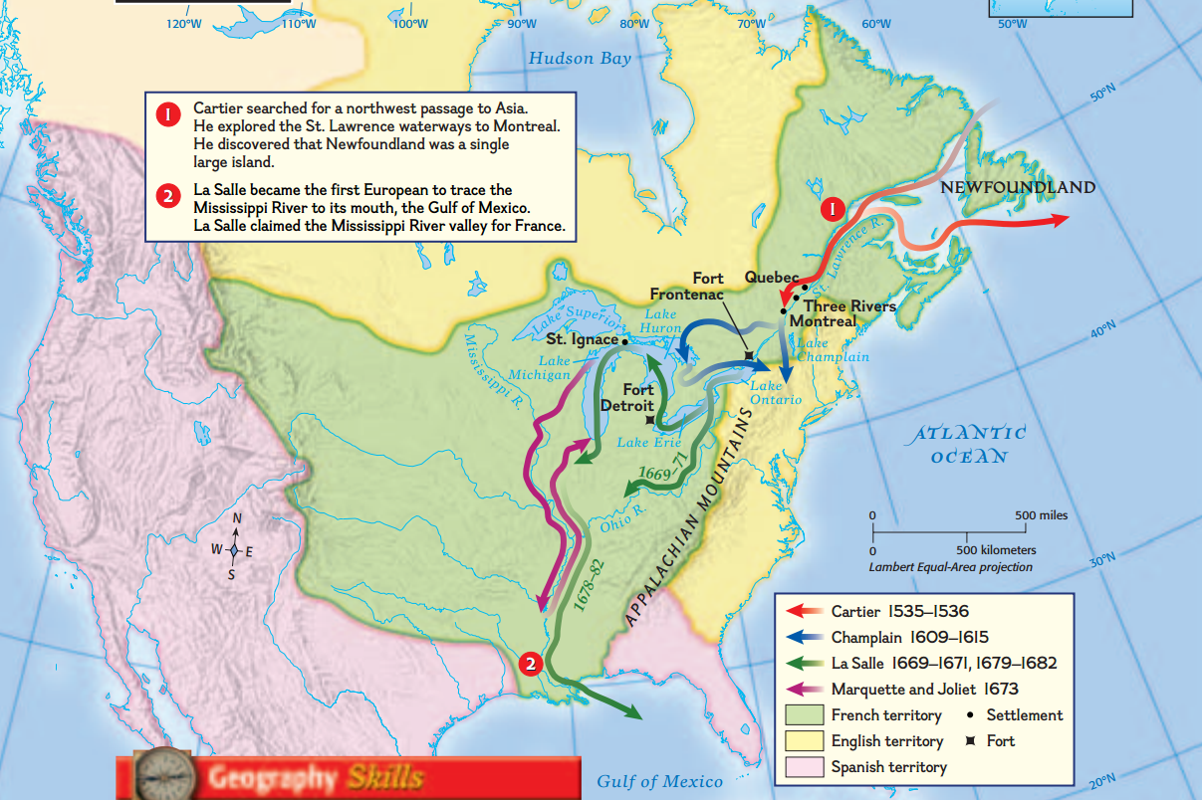
The French Fur Traders
Came in search of the Northwest passage and for new lands to get natural resources, especially furs.
Settled around the St. Lawrence river and the Great Lakes in Canada.
Called the region “New France” and founded major cities like Quebec. The French settlers and fur traders had a mostly friendly relationship with the local Native American Tribes.

Slide 15
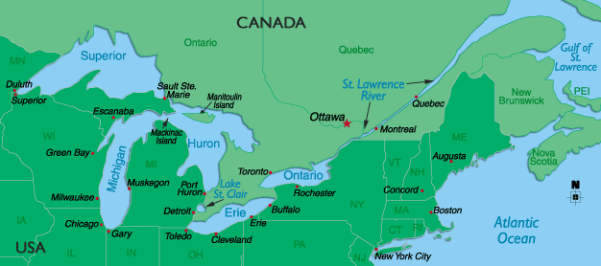
The French Fur Traders
Why do you think the French chose to settle and establish colonies along a major river?

Slide 16
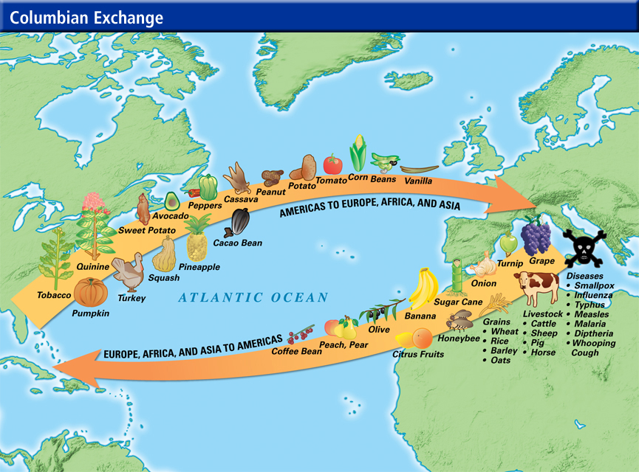
Exploitation and the Columbian Exchange

